Slide 1
MODULE – 1 Portion 1
Basic Concepts of Programming and Java
[Lecture: 4 & Practical: 2]

Slide 2
Contents
Course Handout Discussion
Problem solving
Programming and Types of Programming Languages
Introduction to Java

Slide 3


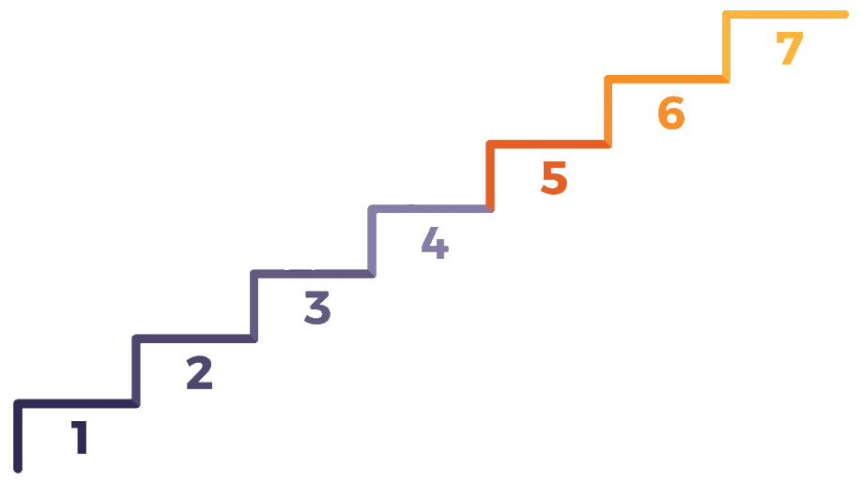

Problem
A problem is a puzzle that requires logical thought or mathematics to solve
A puzzle could be a set of questions on a scenario which consists of description of reality and set of constraints about the scenario.
Follow up on Solution
Implement the Solution
Decide on a Solution
Consider Problem Solutions
Establish Criteria
Problem Solving
Analyze the Problem
Define the Problem

Slide 4
Problem Solving Approach
ALGORITHM
PROBLEM
LOGIC
PROGRAM
What is Program?
An approach to find solution to the Problem
What is Programming ?
Solving Problem in Engineering approach / Systematic Procedure.
What is Programming Language ?
Tool to solve problem
FLOWCHART

Slide 5
How to Develop a Program
Step1: Analyze the problem to identify inputs, outputs and processing requirements
Step2: Identify various processing steps needed to solve the problem and represent them in a particular way (algorithm, flow charts, etc..)
Step3: Refine step 2 in a way that all the processing steps are detailed enough such that every processing step is equivalent to one instruction of the programming language.
Step4: Add syntax of the programming language to the above representation and it becomes the program.
Step5: Type the program and Compile it after removing all syntax related errors.
Step6: Run the program and check it with different types of input to verify its correctness.

Slide 6
Algorithm
Some characteristics of an algorithm are as follows:
Each step of an algorithm must be precisely defined.
An algorithm must contain blocks that will help to solve problems more efficiently and logically.
It should accept a set of inputs and produce a defined output.
It must be terminated after a finite number of steps.
It should be independent from a computer programming language.
It should develop a platform for writing programs.
The algorithm is part of the blueprint or plan for the computer program, an algorithm is:
“An effective procedure for solving a class of problems in a finite number of steps.”
An algorithm is defined as the sequence of instructions written in simple English that are required to get the desired results. It helps to develop the fundamental logic of a problem that leads to a solution.
Every algorithm should have the following 5 characteristic feature:
Input Output Definiteness | 4. Effectiveness 5. Termination

Slide 7
Algorithm
Examples
ALGORITHM
Start
Grind the coffee beans
Add water and milk in a coffee making vessel
Ignite the stove and place the vessel on top of it
Let the mixture to boil and add the coffee powder to the mixture
Filter the mixture
If sugar is not needed then, go to step 9
Else, Add sugar to mixture
If cream is not needed then, go to step 9
Else add cream to the mixture
Serve the coffee in a cup
Stop
Prepare Coffee

Slide 8
Algorithm
Examples
ALGORITHM
Start
Read 3 numbers: num1, num2, num3
if num1 > num2 then go to step 5
if num2 > num3 then
print num2 is largest
else
print num3 is largest
goto step 6
if num1 > num3 then
print num1 is largest
else
print num3 is largest
end.
To Find Largest of Three Numbers
Activity
Q1. Accept the length of two different line segments and check whether they are equal or unequal. Display the message accordingly.
Q2. Accept three numbers and check whether they are 'Pythagorean Triplets' or not. Display the message accordingly.
(Hint: Use Pythagoras Formula for a Right-angled Triangle: h2 = p2+b2)

Slide 9
Flowchart
Basic Flowchart Shapes and Definitions
Split
or
Merge
Manual Input
Rounded box: use it to represent an event which occurs automatically.
Rectangle or box: use it to represent an event which is controlled within the process. Typically this will be a step or action which is taken.
Diamond: use it to represent a decision point in the process.
Circle: use it to represent a point at which the flowchart connects with another process.
Start / End
Upright indicates a process split, inverted indicates a merge of processes.
Prompt for information, manually entered into a system.
The start or end of a workflow.
Decision
Connector
Project / Task
Used to connect one part of a flowchart to another.
Process or action.
Decision point in a process or workflow.
Input / Output
Off Page Connector
Document
Data: Inputs to, and outputs from, a process.
Document or report.
Connector used to connect one page of a flowchart to another.

Slide 10
Flowchart
Example
Coffee Grinder
Start
Grind Beans
Task
Inputs
Merge
Read Instructions
Add Filter
Coffee Pot
Add Coffee
Brew
Brewing Coffee
Document
Add Water
Inputs
Decision
Yes
Cream
Sugar
Pour
Yes
Coffee Mug
No
Decision
Manual Input
Finish
Drink
No
Task

Slide 11
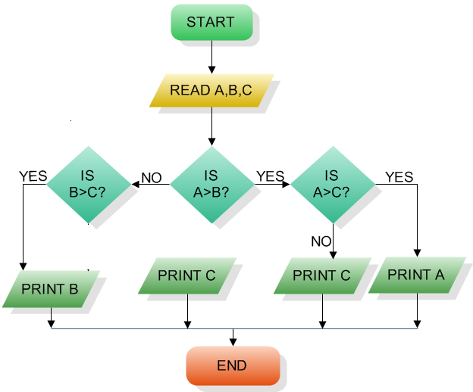
Flowchart to find the largest of three numbers A,B, and C:
Flowchart
Example
Activity
Q1. Accept the length of two different line segments and check whether they are equal or unequal. Display the message accordingly.
NO
Q2. Accept three numbers and check whether they are 'Pythagorean Triplets' or not. Display the message accordingly.
(Hint: Use Pythagoras Formula for a Right-angled Triangle: h = p2+b2)

Slide 12
Computer Programming Languages
A programming language is an artificial language that can be used to control the behavior of a machine, particularly a computer
Programming languages, like human languages, are defined through the use of syntactic and semantic rules, to determine structure and meaning respectively.
Programming languages are used to facilitate communication about the task of organizing and manipulating information, and to express algorithms precisely.
For 50 years, computer programmers have been writing code. New technologies continue to emerge, develop, and mature at a rapid pace. Now there are more than 2,500 documented programming languages!

Slide 13
Types of Programming Languages
Programming Languages
Low Level Languages
High Level Languages
Object Oriented Languages
Machine Language
Assembly Language
4th Generation
1st Generation
2nd Generation
Imperative Languages
Functional Languages
Declarative Languages
3rd Generation

Slide 14
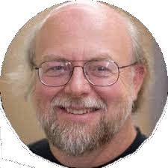


Introduction To Java
James Arthur Gosling often referred to as Dr. Java, OC is a Canadian computer scientist, best known as the founder and lead designer behind the Java programming language.
Java is a famous and widely used object-oriented programming language. It was developed by Sun Microsystems in 1995. Later in 2009, Oracle Corp. acquired Java.
Initially Java called as OAK, Later it is termed as Java ( a name given to coffee bean)
Java is modelled after C++, Java language was designed to be small, simple, and portable across platforms and operating systems, both at the source and at the binary level.
Java also provides for portable programming with AWT.
Notes:
‹#›

Slide 15
Flavor's Of Java
Introduction To Java
JSE
Java Standard Edition formerly known as J2SE.
This forms the core part of Java language.
JEE
Java Enterprise Edition formerly known as J2EE.
These are the set of packages that are used to develop distributed enterprise-scale applications.
These applications are deployed on JEE application servers.
JME
Java Micro Edition formerly known as J2ME.
These are the set of packages used to develop application for mobile devices and embedded systems.
Notes:
Java also comes in several versions:
JDK 1.0 (1995)
JDK 1.1 (1997)
J2SE 1.2 (1998) ) 🡪Playground
J2SE 1.3 (2000) 🡪 Kestrel
J2SE 1.4 (2002) 🡪 Merlin
The above 3 was called Java 2
J2SE 5.0 (2004) 🡪 Tiger
Java SE 6 ( 2006) 🡪 Mustang
Java SE 7 (2011) 🡪Dolphin

Slide 16
Contents
Installation and Demonstration to run a program
Fundamentals
Java Programming - Editing, Compiling and Running a ‘Java’ Program
Integrated Development Environments
Basic Input / Output Stream
Practical exercise

Slide 17
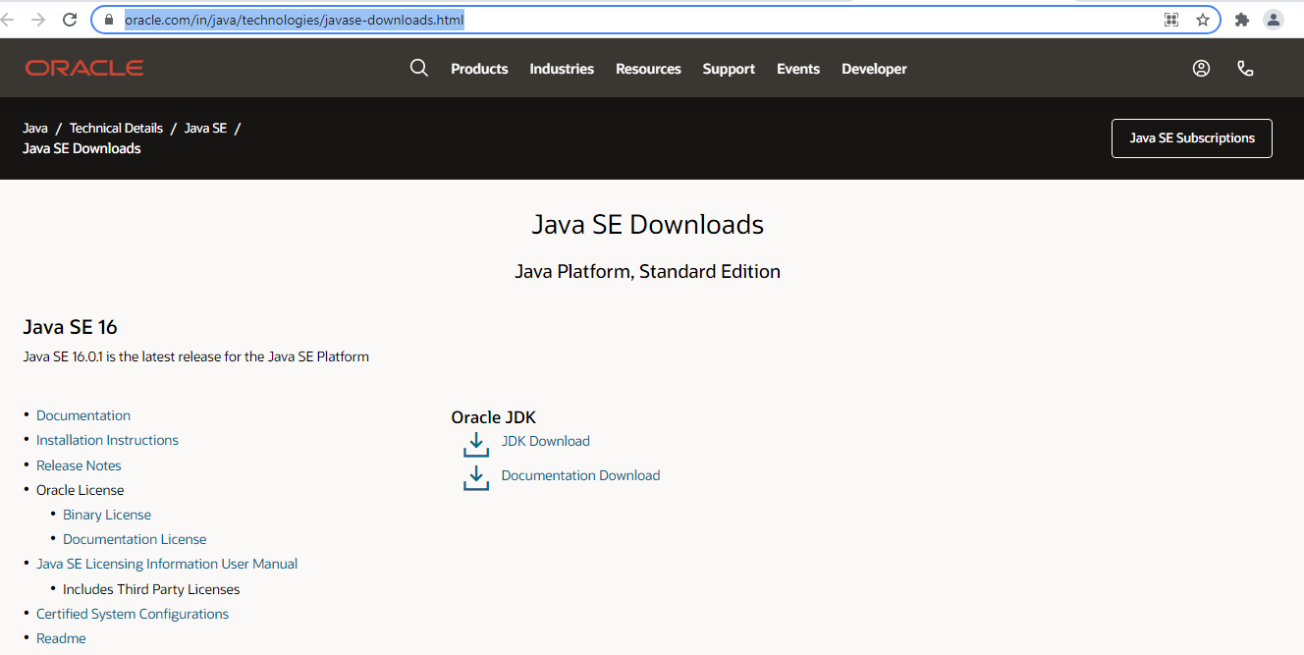
JDK Installation – Java Development Kit
How To Install JDK on Windows
Download JDK@ https://www.oracle.com/in/java/technologies/javase-downloads.html
Install JDK
Click Here

Slide 18
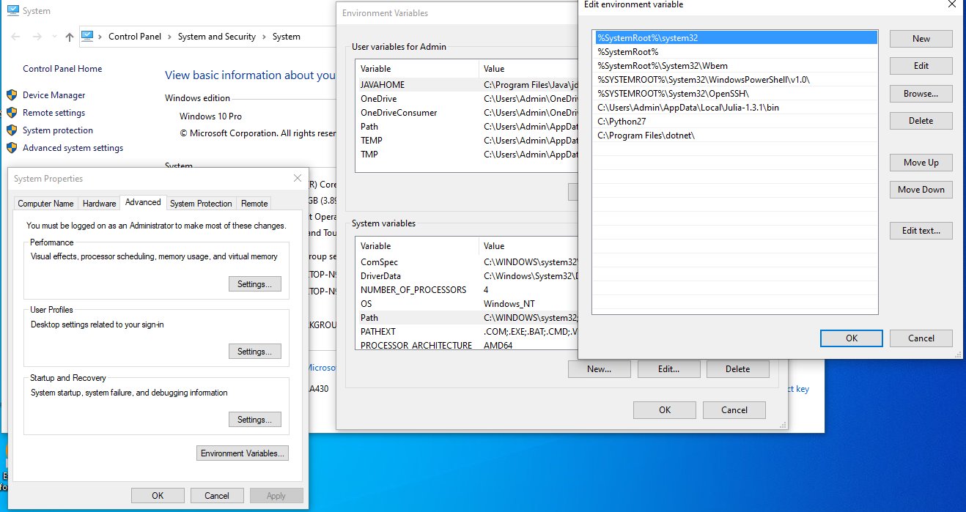
JDK Installation – Java Development Kit
Environment Setup
Include JDK's "bin" Directory in the PATH
Right click mycomputer->Properties
-->Advance Setting
->Click Environment Variable
-> Under System variables
->Select Path and click Edit
->Under Edit menu Click New
->Paste the path of “bin”->ok ->ok
Notes:
‹#›

Slide 19
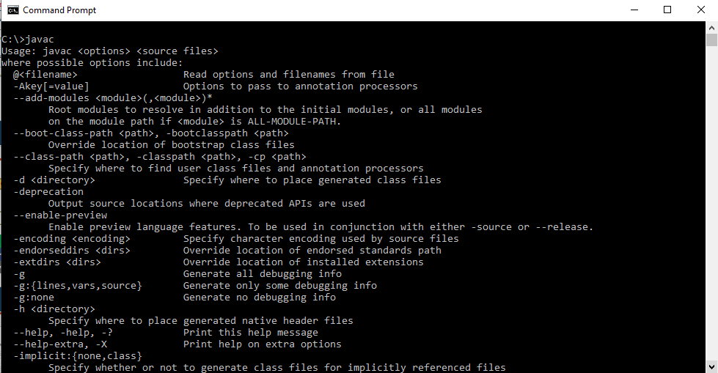
JDK Installation - Confirmation

Slide 20
After JDK Installation
JVM, JRE & JDK – After Installation
JVM
stands for Java Virtual Machine which provides the runtime environment for Java bytecodes to be executed.
JRE (Java Runtime Environment)
includes the sets of files required by JVM during runtime.
JDK (Java Development Kit)
consists of JRE along with the development tools required to write and execute a program.

Slide 21
After JDK Installation
JVM, JRE & JDK – After Installation
SOURCE CODE
Compiler
BYTE CODE
Interpreter
OUTPUT
JVM
JVM + JRE
MACHINE
OPERATING SYSTEM
Interpreter
Memory Management
HARDWARE
JIT/Compiler
MACHINE CODE

Slide 22
After JDK Installation
JVM, JRE & JDK – After Installation
To execute Java program, JRE must be installed in the system
JRE or Java Runtime environment contains
Java Virtual Machine
Standard class libraries (APIs)
Java Plug-in
Java Webstart
JRE gets installed automatically when JDK is installed. JRE can be installed independent of JDK as well. This will mean that Java programs can be executed in that system.
SOURCE CODE
(filename.java)
Compile
BYTE CODE
(filename.class)
Interpreter
JVM
Machine Code
MACHINE
Platform Independent
Platform Dependent

Slide 23




Fundamentals
Java Program Structure

Slide 24
Fundamentals
Editing, Compiling and Running a ‘Java’ Program
Java Programming
Step |  | What is done |  | Command | Comments
1 |  | Editing |  | C:>notepad HelloWorld.java
class HelloWorld { //Note: class name is same as the filename public static void main(String[] args) { System.out.println("Hello, World"); } }
2 | Compiling |  | C:> javac HelloWorld.java |  | The class file “HelloWorld.class” is generated
3 | Executing |  | C:> java HelloWorld |  | Output: Hello World
Notes:
‹#›

Slide 25
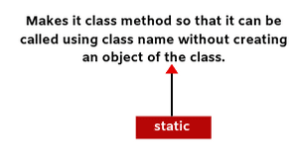
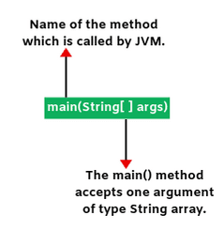
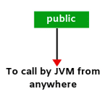
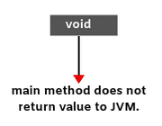
Java Programming
public static void main(String[] args)

Slide 26



Basic I / O
System
Source
Dot(.)
Destination
in
out
System.in
System.out
Input Stream
Output Stream
101010001
Program
101010001
Scanner class ( java.util.Scanner )
Command Line Arguments ( String args[ ] )
System.out.print(“ ”)
System.out.println(“ ”)
And so on…
Notes:
Source: http://www.btechsmartclass.com/java/java-Stream.html

Slide 27
Development Environments
Demonstration of Sample program in Eclipse
There are many programs that support the development of Java software, including:
- Sun Java Development Kit (JDK) - Borland JBuilder
- Sun NetBeans - MetroWerks CodeWarrior
- IBM Eclipse - BlueJ
- jGRASP
Though the details of these environments differ, the basic compilation and execution process is essentially the same.

Slide 28
Activity
Sample program
Q1: Presidency university would like to present its gesture to the visitors by displaying an welcome message to the visitors entering to the campus by taking the name of the visitor at the campus entrance. Help the presidency university by writing an application in java to perform the same. (Hint: Use Scanner Class to take the Input from the User)
Requirement:
Accept the name of person who is entering into the Presidency university campus(ex. First year).
Display the welcome message as “Presidency university welcomes you First year” on the console.

Slide 29
Contents
Command Line Arguments
Wrapper Classes
Data Types
Identifiers
Variables
Literals or Constants

Slide 30
Command Line Arguments
Java Programming
Java Command
Arguments separated by space are sent to main method
Java Demo word0 word1 . . . .
public class Demo {
public static void main ( String args[ ] ) {
for(int i = 0; i<args.length; i++) {
System.out.println("args[" + i + "]: " + args[i]);
} } }
args[0] = “word0”
args[1] = “word1”
and so on

Slide 31
Java Programming
Wrapper Classes
Object
Boolean
Character
Number
String
Java Primitive Wrapper Classes
Byte
Short
Integer
Long
Float
Double

Slide 32
Java Programming
Wrapper Classes
Java Command
Arguments separated by space are sent to main method
Java Demo 1 2 . . . .
public class Demo {
public static void main ( String args[ ] ) {
int value = Integer.parseInt(args[i]);
System.out.println(“args: ” +value);
} } }

Slide 33
Data Types
Data Types
Primitive
Non Primitive
Numeric
Strings
Integer
Floating Point
Arrays
byte
short
float
double
int
long
User Defined Classes
Non-Numeric
Character
Boolean

Slide 34
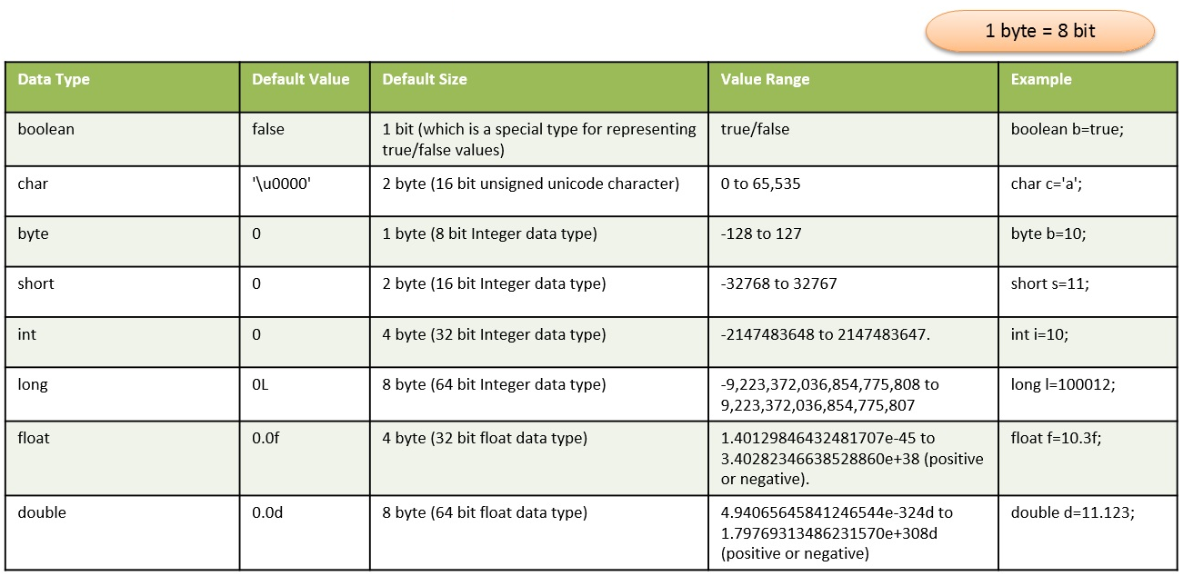
Data Types

Slide 35
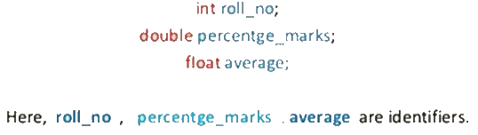

Identifiers
Rules for Identifiers
We can get the valid identifiers from the above code snippet. Now we will see the thumb rules as described following. Java identifier must start with a alphabetic (a-z or A-Z) or Dollar symbol ($) or underscore (_).
Identifiers should not start with a digit (0-9). If we use the digit at starting of it then will get compile time error.
Digits can be used after the first legal character.
No limit for the identifiers length in java but size should be less which is better to maintain understandable identifiers
In Java, all identifiers are case sensitive. Java treats itemsCount and ItemsCount as different identifiers.
Can not be used java inbuilt keywords as identifiers. E.g. static --> is a not valid.
Examples

Slide 36
Variables
public class Person {
private String name;
public void method1(String yourName)
{
String myName;
……… } }
Syntax: Datatype Identifier;
Or
Datatype Identifer=value;
//attribute (instance variable)
//parameter
Forms of Variables
Instance Variables
Local Variables
Class variables
// local variable
public class Demo{
public static void main(String [] args) {
Person obj=new Person();
………
} }
// class variable

Slide 37
Literals or Constants
There are 5 types of Literals or constants in Java language.
Integer Literals (Decimal, Octal, Hexadecimal and Binary Literals)
Floating Point Literals
Boolean Literals
Character Literals
String Literals
JDK 7 introduced two new features namely Binary Literals and Underscores in number literals.
Underscore should not be at the beginning or end. Similarly not before or after a DOT or Decimal Point in floating point or double numbers. Underscore symbols are removed before processing.
Data type | keyword
Constant value | Literal
int Varname = 100;
Name of a Variable | Identifier
Notes:
Source: https://www.examtray.com/java/last-minute-java-programming-data-literals-or-constants-tutorial

Slide 38
Contents
Operators
Assignments and Expressions
Control Statements
Activity

Slide 39
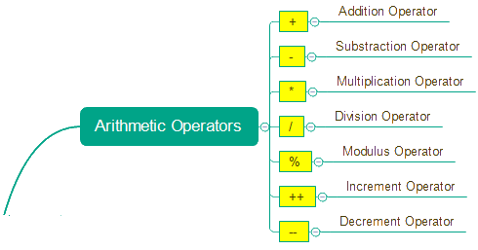
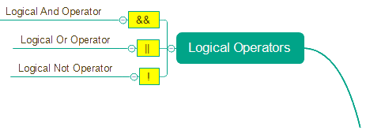
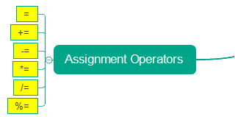

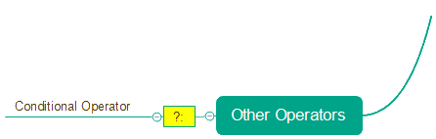
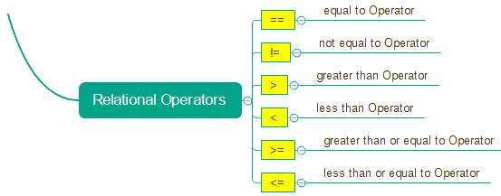
Operators
&
|
^
~
<<
>>
>>>
Bitwise Operators

Slide 40















Operators
Shift operators in Java
Notes:
Source: https://mkyong.com/java/java-and-bitwise-shift-operator/

Slide 41
Assignments & Expressions
Evaluation of Expressions and Type Casting
Widening or Automatic Type Conversion
Widening conversion takes place when two data types are automatically converted. This happens when:
The two data types are compatible.
When we assign a value of a smaller data type to a bigger data type.
Byte short int long float double
Ex: int i=100; float j=i;
Narrowing or Explicit Conversion
If we want to assign a value of a larger data type to a smaller data type we perform explicit type casting or narrowing.
This is useful for incompatible data types where automatic conversion cannot be done.
Here, the target type specifies the desired type to convert the specified value to.
double float long int short byte
Ex: int i=100; byte b=byte(i);
Syntax: variable = expression;
Example:
Score = (10 * Points )+10;
Variable
Expression
Is Assigned to

Slide 42
Control Statements
Control Flow Statements
Decision Making Statements
Looping Statements
Branching Statements
if - then
for
break
for - each
if – then - else
continue
while
switch - case
do - while
return

Slide 43
Activity
Q1. Accept the length of two different line segments and check whether they are equal or unequal. Display the message accordingly. (Hint: Use scanner class to take the input)
Q2. Accept three numbers and check whether they are 'Pythagorean Triplets' or not. Display the message accordingly. (Hint: Use command line arguments and Pythagoras Formula for a Right-angled Triangle: h2 = p2+b2)
Q3. Define a class called Command Line, develop a program in Java that accepts two floats and integers as its command line arguments and perform addition and multiplication on integer inputs, subtraction and division on float inputs and display the result using function/method.

Slide 44
Module – 1 Portion 1 Completed

